Slide 1
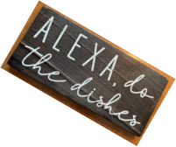
Soar Learning to Make Breakfast
Robots Collaborating with Humans Using Natural Language in the Real World
45th Soar Workshop
Peter Lindes
5 May 2025
Assisted by Kaoutar Skiker

Slide 2
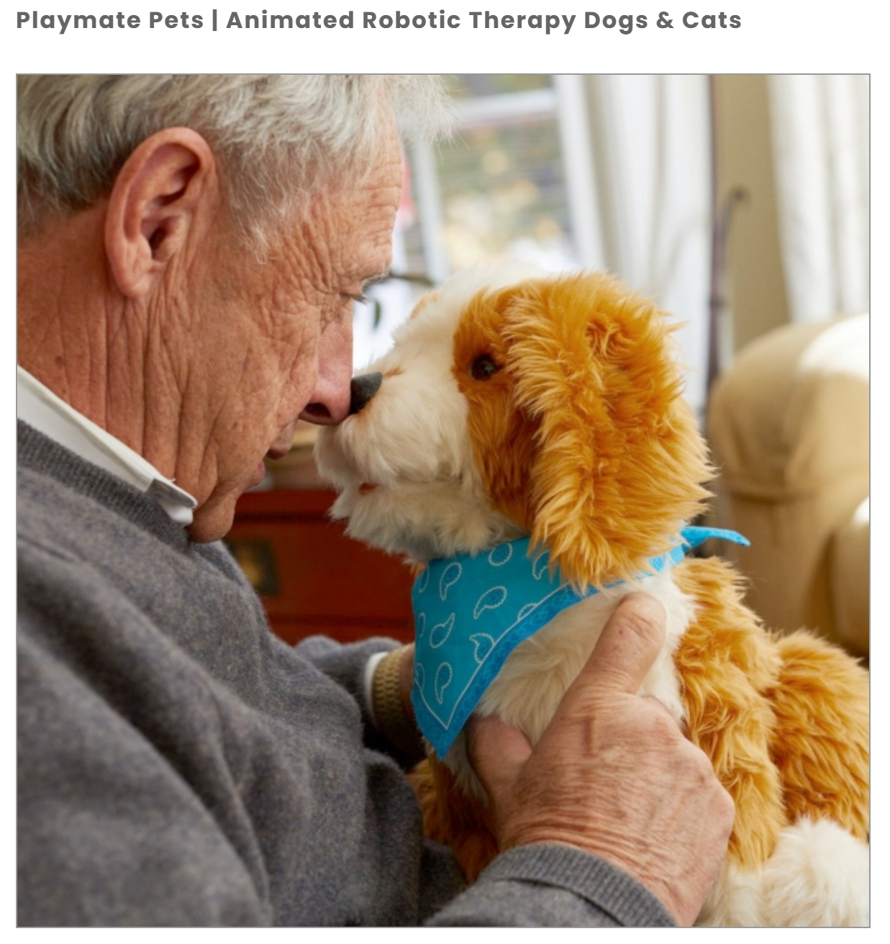
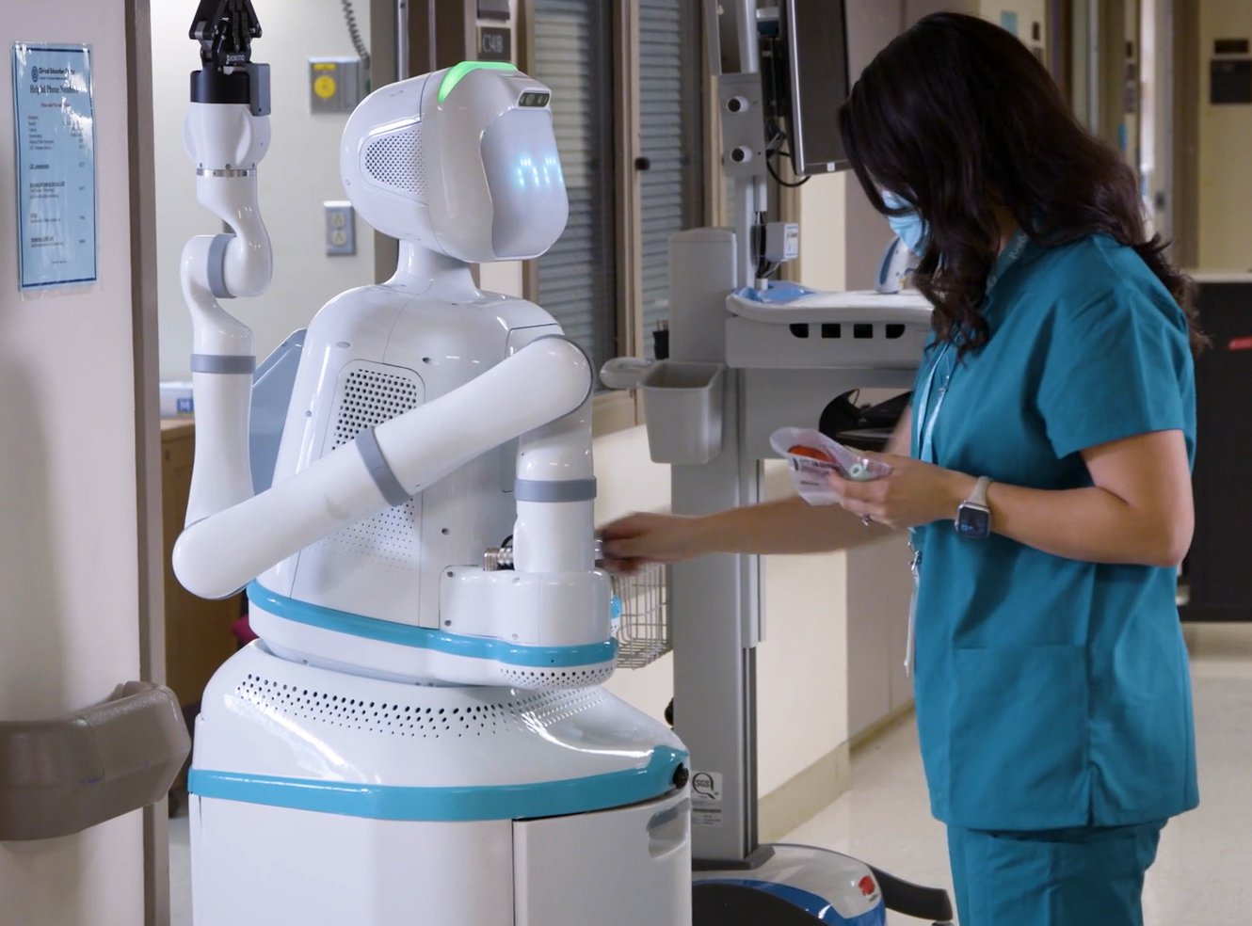
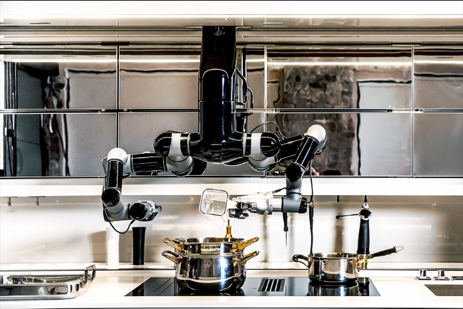
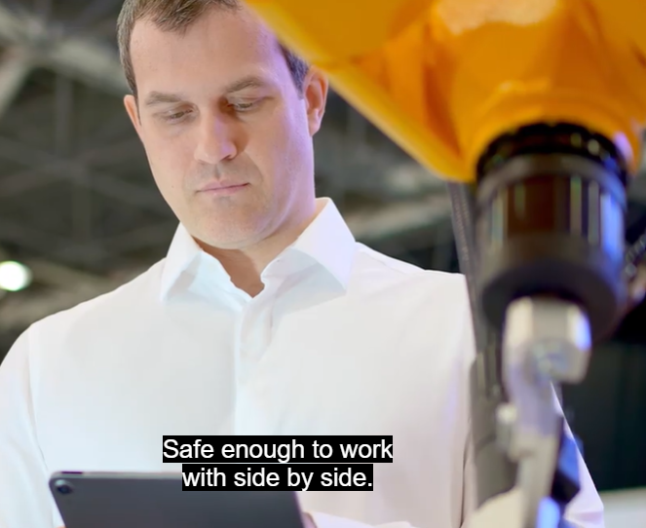
Robot Assistants
What’s missing in all of these?
The ability to interact using language natural to humans
The ability to learn and reason about a large, complex body of situational knowledge

Slide 3
Objective: Robot assistants with language
Imagine hiring a human cook and giving them a lot of training.
Then imagine replacing that person with a robot.
Hard problems:
Vision
Manipulation
Navigation
Knowledge and reasoning
Language understanding
Existing approaches:
Classic ITL
Limited language
Limited knowledge
Agentic LLMs
Not grounded
Limited reasoning

Slide 4
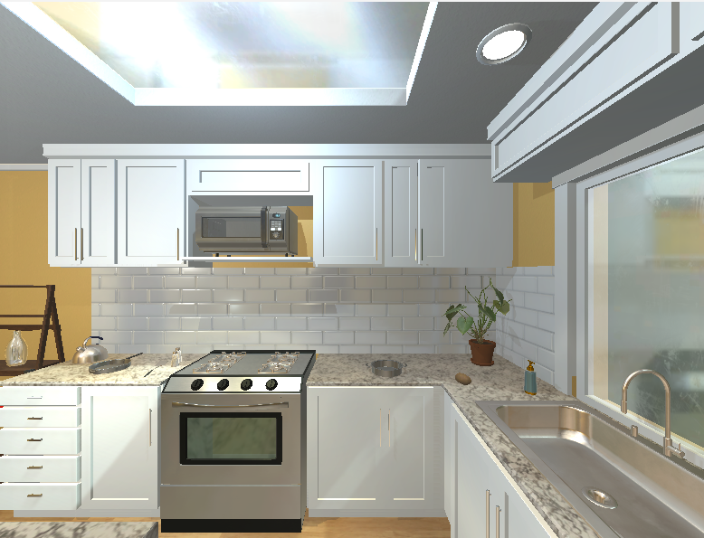
Use Case: A Kitchen Assistant (a private cook)
Tasks:
Prepare meals
Serve meals
Clean up
Maintain inventory
Make shopping list
Order groceries
Store groceries
Knowledge needed:
Kitchen layout
Storage locations
Ingredients
Recipes
Tools
Cleaning procedures
Personal preferences
Current inventory
Ordering procedures
You: I’m hungry. What’s for breakfast?
Cook: What would you like for breakfast today?
You: Well, maybe some toast and an omelet.
Cook: You like your toast buttered and with jam, right?
You: Sure, sounds good.
Cook: We’re out of cheddar cheese. Is Swiss OK?
You: Well, I guess that’ll do. Be sure to get some cheddar!
Cook: Will do.
(Goes off and prepares the breakfast and serves it.)
Cook: Here’s your breakfast. You: Great, thanks!
(Cleans up the kitchen and orders cheddar cheese.)

Slide 5
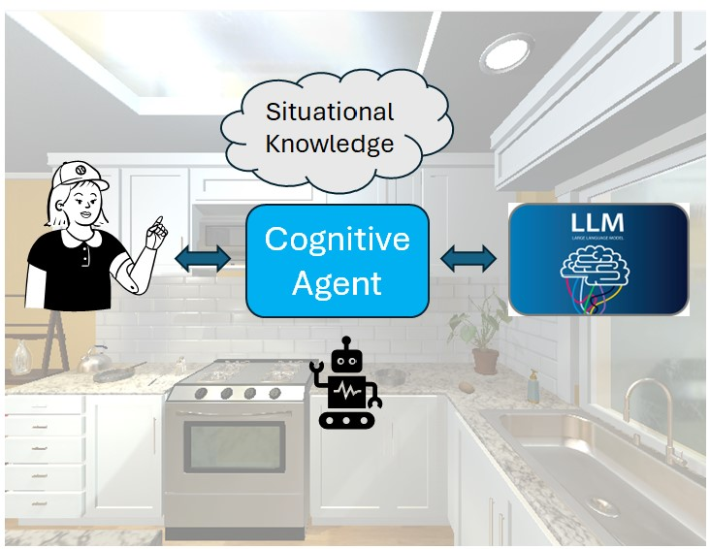
A New Approach
Agent:
Integration
Knowledge:
Situation
Preferences
Tasks
Human:
Overall direction
Knowledge from interaction
LLM:
Language translation
General knowledge
Robot:
Perception
Action
We have experience in all these areas.

Slide 6
Three Dimensions of the Problem
Making free-form language understandable to the agent
Using interactions to learn the knowledge for complex tasks
Generalizing this knowledge over multiple tasks

Slide 7
Example of Knowledge from LLM
Request to ChatGPT: (2/20/2025, 11:18am MST)
I need a recipe for making scrambled eggs. Please give it to me as a list of a few simple steps.
Response from ChatGPT:
Here’s a quick and easy recipe for scrambled eggs:
Ingredients:
2–3 eggs
Salt (to taste)
Pepper (to taste)
1 tbsp butter (or oil)
Optional: Milk or cream (1–2 tbsp for creamier eggs)
Steps:
Crack the eggs into a bowl and beat them with a fork or whisk until fully combined.
Add a pinch of salt and pepper to the eggs. Optionally, add a splash of milk or cream for a creamier texture.
Heat a non-stick pan over medium-low heat and add the butter.
Pour the eggs into the pan once the butter has melted, swirling the pan to coat the bottom.
Cook gently, stirring occasionally with a spatula, until the eggs are soft and slightly runny or fully cooked to your liking.
Serve immediately and enjoy your scrambled eggs!
Let me know if you'd like to adjust the recipe to your taste!
Agent must learn:
Ingredients
Measures
Actions
Manners
Criteria
Translation to formal representations
Human interaction
for details
and verification

Slide 8
Issues in Grounded Language Understanding
Non-standard language
Free form, ungrammatical
Indirect
Abbreviated
Many alternatives
Object references
Verb meanings
Abstract concepts
Individual variations

Slide 9
Challenging References
Spatial relations
Discourse properties
Goal: Put a cooked potato slice on the counter.
Goal: Place a slice of cooked potato onto the counter.
Goal: Put a piece of cooked potato on the counter.
round table with tablecloth
The table
The gray table
The knife
yellow handled knife
The knife from in between the lettuce and the apple
The knife
the knife used to cut the potato
counter
counter with blue plate on it
the counter left of the bread
the counter near the soap container
the counter in front of the stove
the counter left of the bread
the counter
the kitchen counter with the loaf of bread
the counter top with the loaf of bread
A slice in the potato
Potato slice
The potato slice
The potato
A slice of potato
The cooked potato slice
The potato on the gray table
A slice of the cut potato
The potato slice
Examples from ALFRED dataset:
Shridhar et al. (2020), ALFRED: A Benchmark for Interpreting Grounded Instructions for Everyday Tasks.. arXiv:1912.01734v2

Slide 10
Learn to “cook”
Cook <something>.
Issues to consider
Cook a potato.
Cook a potato in the microwave.
Make my breakfast.
Prepare dinner for the family.
Fix me an omelet.
Cook eggs benedict.
Boil an egg (hard or soft?)
Overall context
Who will be eating, preferences
What, where and when
Presentation and serving
Cleanup and maintenance
Results: entities ready to eat:
An individual food item (toast)
A dish (scrambled eggs)
A meal (breakfast)
Verbs in context
Learning

Slide 11
Making Breakfast Dialog
A dialog with a human cook
A dialog with a well-trained Thor-Soar
You: I’m hungry. What’s for breakfast?
Cook: What would you like for breakfast today?
You: Well, maybe some toast and an omelet.
Cook: You like your toast buttered and with jam, right?
You: Sure, sounds good.
Cook: We’re out of cheddar cheese. Is Swiss OK?
You: Well, I guess that’ll do. Be sure to get some cheddar!
Cook: Will do.
(Goes off and prepares the breakfast and serves it.)
Cook: Here’s your breakfast. You: Great, thanks!
(Cleans up the kitchen and orders cheddar cheese.)
You: Make my breakfast.
Thor-Soar: Would you like your regular breakfast today?
You: Yes.
Thor-Soar: I will make and serve your breakfast.
(Goes off and prepares the breakfast and serves it.)
Thor-Soar : Your breakfast is served.
You: Thank you!
(Thor-Soar puts cooking tools in the sink.)
(You eat your breakfast.)
You: I am done.
(Thor-Soar cleans up the table, puts all the dirty dishes in the dishwasher and turns it on. When the dishwasher is done it puts all the dishes away in their places.)
Free-form language
Full situational knowledge
Constrained language
Learned situational knowledge

Slide 12
Subtasks of Make Breakfast
Make breakfast
Desired items
Table setting
Item preparation
Item serving
Cleanup
Issues:
Learning dialogs
Knowledge representation
Incremental generalization
Interleaving subtasks

Slide 13
Learning open
I: Open the fridge.
TS: What are the preconditions for this action?
I: The fridge is reachable and you are not holding anything.
TS: What will this action accomplish?
I: The fridge is open.
TS: What is the name of the output command?
I: open
TS: Thank you, I will try to perform the action.

Slide 14
Examples of Generalization Issues
What about opening a microwave that is turned on?
I: Open the fridge.
TS: What are the preconditions for this action?
I: The fridge is reachable and you are not holding anything.
Where should we put an empty soda can?
I: Discard the apple.
TS: What is the goal of discard?
I: The goal is that the apple is in the garbage can.
Multiple action models or variations of a single one?
Can Soar “forget” a chunk after it has been learned?

Slide 15


Nuggets
Coal
Soar can manage complex tasks
Soar can learn situational knowledge
Soar can get an LLM to help it understand human language
Soar can get general knowledge from an LLM
Soar and an LLM can cooperate to make robotic assistants
Using an LLM to make language understandable is a challenge
Coordinating ITL and an LLM to learn situational knowledge is a challenge
Grounding language to the physical world is a challenge

